Slide 1

ENGINEERING CHEMISTRY
Asha A
Department of Science and Humanities

Slide 2

ENGINEERING CHEMISTRY
Module 7A- Organic Light Emitting Diodes
Module content:
Organic Light Emitting Diodes

Slide 3
ENGINEERING CHEMISTRY
Module 7A- Organic Light Emitting Diodes
Class content:
Organic Light Emitting Diodes
Construction
Working
Advantages
Disadvantages
Applications

Slide 4
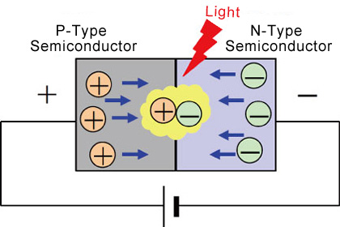
ENGINEERING CHEMISTRY
Module 7A- Organic Light Emitting Diodes
Light Emitting Diodes (LEDs)
Source:https://www.rohm.com/electronics-basics/leds/what-are-leds
Consists of a n - type and p-type semiconductor forming a p-n junction. Material like Gallium Arsenide(GaAs) is used . When voltage is applied across the junction , the electrons and holes combine in the depletion layer giving out photons

Slide 5
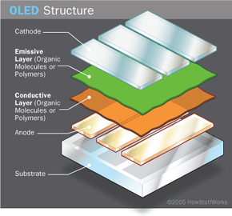
ENGINEERING CHEMISTRY
Module 7A- Organic Light Emitting Diodes
Organic Light Emitting Diodes (OLEDs)
Work in a similar way to conventional diodes and LEDs, but instead of using layers of n-type and p-type semiconductors, they use organic molecules
OLEDs have an emissive electroluminescent layer which is a film of organic compound that emits light in response to an electric current
Also known as organic EL (electroluminescent) diodes
Solid-state devices made of thin films of organic molecules that emit light on application of electricity

Slide 6

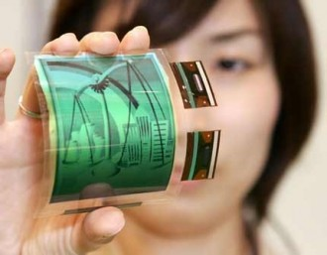
ENGINEERING CHEMISTRY
Module 7A- Organic Light emitting diodes
First OLED device was made by Eastman Kodak in the 1980’s
Emerging technology for displays
Displays which are flexible, very thin, light weight
Less power consumption than conventional LEDs and LCDs
Offer high contrast, brighter displays with wider viewing angle
Source:https://www.techspot.com/news/48578-lg-preparing-flexible-oled-display-plant-for-production.html
Source:https://www.geeky-gadgets.com/sonys-rollable-oled-display-more-details-26-05-2010/

Slide 7

ENGINEERING CHEMISTRY
Module 7A- Organic Light Emitting Diodes
Construction:
Substrate: glass for support
Anode : transparent usually made of Indium Tin Oxide(ITO)
Conductive layer : Organic molecules or polymers – transports holes from the anode; polyaniline
Emissive layer : organic molecules or polymers- transports electrons from the cathode, recombination of holes and electrons takes place here and light is emitted; polyfluorene
Cathode : injects electrons ; metals like Mg
Source:https://electronics.howstuffworks.com/oled1.htm

Slide 8
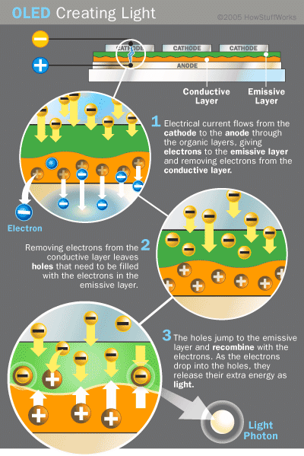
ENGINEERING CHEMISTRY
Module 7A- Organic Light Emitting Diodes
Working:
A voltage is applied across the anode and cathode of the OLED
Electrons flows from cathode to anode through the organic layers
Electrons are transported to the emissive layer from cathode
Holes are transported to the conductive layer from anode
Electrons combine with the holes thereby emitting light
Recombination happens closer to the emissive layer
Colour of light depends on the organic molecules used and intensity depends on current density
Source:https://www.researchgate.net/figure/Basic-OLED-working_fig2_308332988

Slide 9
ENGINEERING CHEMISTRY
Module 7A- Organic Light Emitting Diodes
Advantages :
The organic layers of an OLED are thinner, lighter and more flexible than the crystalline layers of LED or LCD
Brighter than LEDs because the organic layers of an OLED are much thinner than the corresponding inorganic crystal layers of an LED, the conductive and emissive layers of an OLED can be multi-layered
Consume much less power
Easier to produce and can be made to larger sizes
Have large fields of view; about 170 degrees
High color contrast and faster response time

Slide 10
ENGINEERING CHEMISTRY
Module 7A- Organic Light Emitting Diodes
Disadvantages:
Have shorter life span
Manufacturing process is expensive
Water can easily damage them

Slide 11

ENGINEERING CHEMISTRY
Module 7A- Organic Light Emitting Diodes
Applications:
Source:https://www.slideshare.net/ADRIJA_CHOWDHURY/performance-analysis-of-luminescent-materials-for-oled-applications

Slide 12
ENGINEERING CHEMISTRY
Module 7A- Organic Light Emitting Diodes
End of Module 7A

Slide 13
ENGINEERING CHEMISTRY
Module 8- Green Chemistry
Class content:
Green Chemistry
Definition
Twelve principles

Slide 14
ENGINEERING CHEMISTRY
Module 8- Green Chemistry
Definition
‘Green Chemistry’ is the utilization of a set of principles that reduces or eliminates the use or generation of hazardous substances in the design, manufacture and application of products
-Paul T. Anastas and John C. Warner

Slide 15
ENGINEERING CHEMISTRY
Module 8- Green Chemistry
Green Chemistry focuses on :
Reduction, recycling and/or eliminating toxic substances
Finding creative, alternative routes to minimize impact on the environment
More eco-friendly green alternative to conventional chemistry practices
Provides sustainable development, sustainable business and sustainable living practices

Slide 16
ENGINEERING CHEMISTRY
Module 8- Green Chemistry
Twelve Principles of Green Chemistry
Prevent Waste | Use of renewable feedstocks
Atom Economy | Reduce Derivatives
Safer Synthesis | Catalysis
Safe Products | Design for Degradation
Design Benign Chemicals | Pollution prevention
Design for Energy Efficiency | Accident Prevention

Slide 17
ENGINEERING CHEMISTRY
Module 8- Green Chemistry
Prevent Waste :
Synthesis only targeted product with minimum or no
by products/waste
If waste is produced , it involves cost and time to treat and safely dispose it, as a result production cost increases

Slide 18
ENGINEERING CHEMISTRY
Module 8- Green Chemistry
Atom Economy :
Synthetic methods should be
designed to maximize the incorporation of all materials used into the final product
The chemical processes should have maximum product yield
Atom economy can be calculated using the relation
% Atom Economy = (FW of atoms utilized/FW of all reactants) X 100
Atom Economy in a Substitution Reaction - moderate
Atom Economy in Elimination Reactions - low
Atom Economy in Addition Reactions -100%
Atom Economy in Rearrangement Reactions -100%
For a green synthesis atom economy must be maximum (100%)

Slide 19
ENGINEERING CHEMISTRY
Module 8- Green Chemistry
Safer Synthesis :
The synthetic processes should be
designed so as to minimize or prevent the production of hazardous substances
Necessary safety precautions have to be taken while processing to protect human health and environment
e.g.,
Polyurethane is manufactured conventionally using isocyanate and alcohol. However, isocyanate is produced using phosgene, a toxic gas
The alternative method by green synthesis of polyurethane eliminates the use of phosgene and uses CO₂

Slide 20
ENGINEERING CHEMISTRY
Module 8- Green Chemistry
Safe Products :
Chemical products should be designed
to preserve efficacy of function while reducing toxicity
Products should not have any side effects on the people using it and on the environment
It is envisaged to produce the chemical products specially those being used in cosmetics, pharmaceuticals, etc.

Slide 21
ENGINEERING CHEMISTRY
Module 8- Green Chemistry
Design Benign Chemicals :
Use safer solvents and reaction conditions
Avoid using solvents, separation agents, or other auxiliary chemicals
If these chemicals are necessary, use innocuous chemicals
Chemical syntheses are assisted by solvent medium:
recommended to use alternative solvents , greener in nature such as aqueous medium, liquid carbon-dioxide, ionic liquids(N-alkyl pyridinium cation with BF₄⁻ ) , or solvent free systems
Avoid harmful solvents like chloroform, pyridine which are known to cause health hazard, are carcinogenic to human beings and animals or cause severe damage to environment

Slide 22
ENGINEERING CHEMISTRY
Module 8- Green Chemistry
Design for Energy efficiency :
Chemical processes are to be designed in such a way
that they are less energy intensive
reactions occurring at mild conditions
require less time to complete
For this purpose it is worthwhile to utilize
Bio-catalyst, homogeneous and heterogeneous catalyst which reduces the energy of activation
Modern techniques such as solvent free synthesis, supercritical fluid systems, microwave irradiation, and ultrasound

Slide 23
ENGINEERING CHEMISTRY
Module 8- Green Chemistry
Use of renewable feedstock :
Raw material or feedstock used as starting material should be renewable rather than depleting wherever technically and economically possible
Use of renewable feedstock such as biomass and agricultural wastes are strongly recommended rather than using non-renewable resources such as coal, petroleum-based raw materials, etc.

Slide 24
ENGINEERING CHEMISTRY
Module 8- Green Chemistry
Reduce Derivatives :
Avoid unnecessary derivatization
temporary modification should be avoided whenever possible as they generate waste
the atom efficiency is reduced as the protective group is not incorporated in the final product
e.g.,blocking group, protection/ deprotection

Slide 25
ENGINEERING CHEMISTRY
Module 8- Green Chemistry
Catalysis :
Use catalytic reactions, as catalysts
Speed up the reaction
can be recycled and are highly selective
less energy consumption during reaction
obtaining high yield of product of high purity
Unlike stiochiometric reactions which are energy intensive require excessive reagents

Slide 26
ENGINEERING CHEMISTRY
Module 8- Green Chemistry
Design for Degradation :
Design chemicals and products to degrade after use to innocuous substances after use so that they do not accumulate in the environment
Especially applicable to
insecticides
pesticides
polymers
which tend to persist in the environment and are known to cause bioaccumulations

Slide 27
ENGINEERING CHEMISTRY
Module 8- Green Chemistry
Pollution Prevention :
Real-time analysis (quality control)
Continuously monitor and control the formation of hazardous substances
Any unreacted reactant can be recycled in order to minimize the use of chemicals

Slide 28
ENGINEERING CHEMISTRY
Module 8- Green Chemistry
Accident Prevention :
Minimize the potential for accidents
Chemicals chosen for processes should be such which minimise accidents in the form of fires, explosions, and toxic releases to the environment
Manufacturing plants should be well equipped with safety mechanisms
The Bhopal gas tragedy is one of the worst industrial disasters

Slide 29
ENGINEERING CHEMISTRY
Module 8- Green Chemistry
Green chemistry is a set of principles which emphasises on
environmentally benign chemical synthesis with a view to devise pathways for the prevention of pollution
bringing a paradigm shift in chemical processing to achieve sustainable development
GO GREEN

Slide 30
ENGINEERING CHEMISTRY
Module 8- Green Chemistry
End of Module 8
End of UNIT V

Slide 31
THANK YOU
Asha A
Department of Science and Humanities

